Slide 1


Jim Antonisse, WiSC/NGA-TAEB Supporting Mirsada Beganovic, NGA/TAEB 28 October 2025
A Cost/Benefit Framework for GeoPose
- a novel (??) shot at addressing Adoption
The 133rd OGC Member Meeting/Geopose SWG, Boulder, Colorado USA
Meeting Host
Meeting Sponsor

Slide 2


NGA Interest in GeoPose (in general)
Goal < propose a Standard way to express uncertainty/confidence in GeoPose
National Geospatial-Intelligence Agency (NGA)
NGA’s Mission:
“Know the World, Show the Way…from Seabed to Space”
Knowing the world means
Understanding as precisely as possible
What is Where
Views and opinions expressed here are my own
and do not necessarily represent official views of the NGA
-- Jim.

Slide 3
Agenda
Status
OGC Standard that is ready for adoption (but not yet widely adopted)
Current Goal
Mandate the Standard Decide whether to mandate this standard
Approach
Cast as a cost/benefit analysis & decision
Progress
Suggestive heatmap of cost/benefit landscape
Next
Recruit participants to reify the cost/benefit tables

Slide 4
Status < GeoPose Adopted (but not yet widely) .

Slide 5
GeoPose Status
Status < OGC Standard that is ready for adoption (but not yet widely adopted)
GeoPose has been entered as “Emerging” in the official registry of US DoD and IC IT Standards
The registry of Standards for this community is the “DISR” – the DoD Information Technology Standards Registry.
The body responsible for Standards related to GeoSpatio/Temporal Standards for that community is the National Geospatial-Intelligence Agency – NGA
This work is proceeding under the wing of Mirsada Beganovic of NGA/TAEB, NGA’s Requirements and Standards division.
GeoPose is not currently Mandated for use in that community

Slide 6
Mandating GeoPose for the UD DoD/IC
Goal < decide whether to mandate this standard
Note that having a Standard adopted by the US DoD/IC by mandating it is different from the way Standards get adopted in the commercial sector, which is voluntary.
Given the unique nature of Standards adoption in the DoD/IC, are we actually ready for this step?
Need the Standard to be well-defined √
Need the Standard to be adopted by an established (Industry/International) Standards organization √
Need at least three implementations (preferably is the DoD/IC) √
And… need a compelling reason why mandating the Standard would be of significant benefit to the DoD/IC X
Notes:
Transitioning to Mandated Standard
Need broad consensus that:
GeoPose will be of significant benefit to standardize for DoD/IC
Is cost-effective to implement
Would be useful to draw out the specific programming tasks that are/are not required for GeoPose to do its work. E.g., what is changed in the integration of SOCET objects into Google/ESRI, of MISB KLV into Cesium, etc.
Will be adopted by Brits? Aussies? Etc.
3+ implementations
DoD/IC for DoD/IC Standards mandate
Specifically targeting Army Geo Center, NGA’s 3D Standards group, MISB/GIMI work… USAF?
Suggest a deepening of motivating scenario (incl programming actions req’d for interop of diverse tools)
There is a process to bring potentially beneficial standards forward for consideration for mandating to the US DoD/IC community
In the Geospatial Intelligence (GEOINT) arena this process is orchestrated through the GEOINT Standards Working Group (GWG) and its Focus Area subcommittees.
NGA manages (but does not own) the GWG process.
Potential Standards are nominated, and then vetted, by the community through the auspices of the GWG. I.e., the GWG is the gateway for Standards in the US DoD/IC.
The GWG is very familiar with OGC and has adopted many of OGC’s standards as Mandated across the DoD and IC
(JA’s role in this all this is Subject Matter Expert and is proceeding as a contractor under the wing of Mirsada Beganovic of NGA/TAEB, NGA’s Requirements and Standards division.)

Slide 7
Goal: Mandate GeoPose Decide whether to mandate GeoPose .

Slide 8
A New Goal (?)
Goal < decide whether to mandate this standard
This work is dedicated to addressing that last observation
… need a compelling reason why mandating the Standard would be of significant benefit to the DoD/IC X
Goal: Provide a Cost/Benefit Analysis for GeoPose (in the DoD/IC arena)
OK, yes, we’ve been doing this – but only implicitly, it seems
The idea is to develop a Cost/Benefit analysis that is explicit – ultimately to be a checklist
The focus will be on the UD DoD/IC arena
With a hope that this will turn out relevant to the ”Why adopt OGC Standards” question in other areas
(OK, this task seems kinda impossible… but maybe we can sketch out something useful? … maybe with the help of AI??)
(note: sketch out)
Notes:
Ideally: A Cost/Benefit analysis based on real data from an account of costs and benefits across attributes that matter and those within a set of application scenarios that matter.
But this is unrealistic right now
Propose, instead, a sketch of costs and benefits
i.e., an account of costs and benefits that consist of illustrative estimates that are sufficiently evocative to help decide the issue or result in some specific and concrete studies or investigations to ascertain bestter estimates of costs and benefits
Think of this analogously to Subjective vs Frequentist Bayesian Modeling :)
Then use that sketch to evoke responses and stoke engagement is assessing merits of analysis … and of GeoPose itself
The following “analysis” represents a sketch of the costs and benefits of mandating GeoPose in the DISR
… And it is brought to you through the auspices of current AI technology (so, yes, we’ll see)

Slide 9
Approach < Cast as a cost-benefit analysis & decision .

Slide 10
What are the dimensions of Benefit that we care about?
Goal < decide whether to mandate this standard
How about:
In the DoD/IC most of the energy in standardization is devoted to achieving Interoperability, so will concentrate on that.
The DoD/IC uses the DISR to establish Standard data interchanges between suites of information systems to achieve an Interoperability across DoD/IC communities, and the STANAGs to achieve it within NATO
So the fact is that the DoD/IC already has ways of achieving Interoperability and we’re arguing for a change in DoD/IC operations.
The FAIR principles:
Findability
Access
Interoperability
ReUse
… and Fairness
As in “Trustworthiness” >>>
AI Trustworthiness - NIST
Valid and Reliable
Safe
Secure and Resilient
Accountable and Transparent
Explainable and Interpretable
Privacy-Enhanced
Fairness with Harmful Bias Mitigation
Notes:
AI Overview
The National Institute of Standards and Technology (NIST) outlines seven characteristics of trustworthy AI in its AI Risk Management Framework (AI RMF 1.0)
. These factors provide the foundation for responsibly developing, deploying, and using AI systems.
The seven factors are:
Valid and Reliable: The AI system performs as intended and produces correct, repeatable results. It maintains its performance over time and can be relied upon to operate consistently.
Safe: The system operates in a way that avoids causing unacceptable risks of harm to people, property, or the environment. This characteristic requires anticipating and mitigating potential hazards.
Secure and Resilient: The system is protected from unauthorized access, use, or modification (security). It is also able to withstand and recover from adverse events and disruptions while continuing to perform its function (resilience).
Accountable and Transparent: Developers, deployers, and users of the system can be held responsible for its outcomes and impacts (accountability). It is also possible to know when an AI system is in use, understand its purpose, and have access to sufficient information to evaluate its performance (transparency).
Explainable and Interpretable: The system's inner workings are understandable, and its output can be explained. Explainability and interpretability help people understand how the AI arrived at a particular decision or result, building trust and enabling meaningful oversight.
Privacy-Enhanced: The system is designed and used to protect data and respect individual privacy. This includes managing data properly, implementing privacy protections, and adhering to relevant laws and regulations.
Fairness with Harmful Bias Mitigation: The system is designed to treat different individuals and groups equitably and to proactively address and mitigate potential biases that could cause harm. This involves identifying and addressing sources of unfairness throughout the AI lifecycle.

Slide 11
“between suites of information systems”
Approach < Cast as a cost-benefit analysis & decision
Have generated a grab-bag of systems/suites to get started
OGC's DGGS
OGC's GeoDataCube
OGC's Connected Systems
OGC's 3D Tiles
ESRI
QGIS
Cesium
Google Earth
Oculus
Apple Vision Pro
Existing Standards
GIS Systems
Realtime GeoVis Environments
Augmented Reality Applications

Slide 12
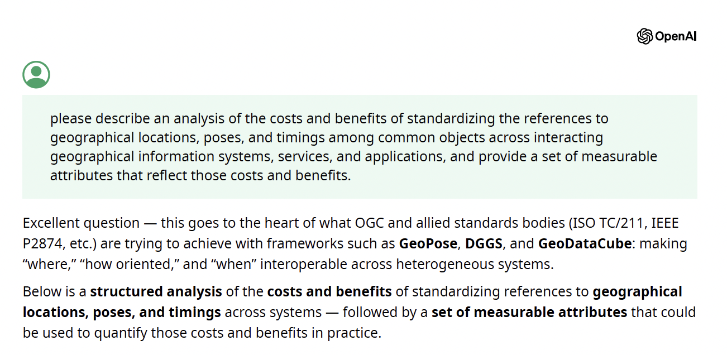
The initial prompt…
OpenAI’s ChatGPT5
Ignore the obsequious intro
Happily the references in the prompt to “standardizing” and “poses” seem to ave got it to bring GeoPose into its considerations

Slide 13
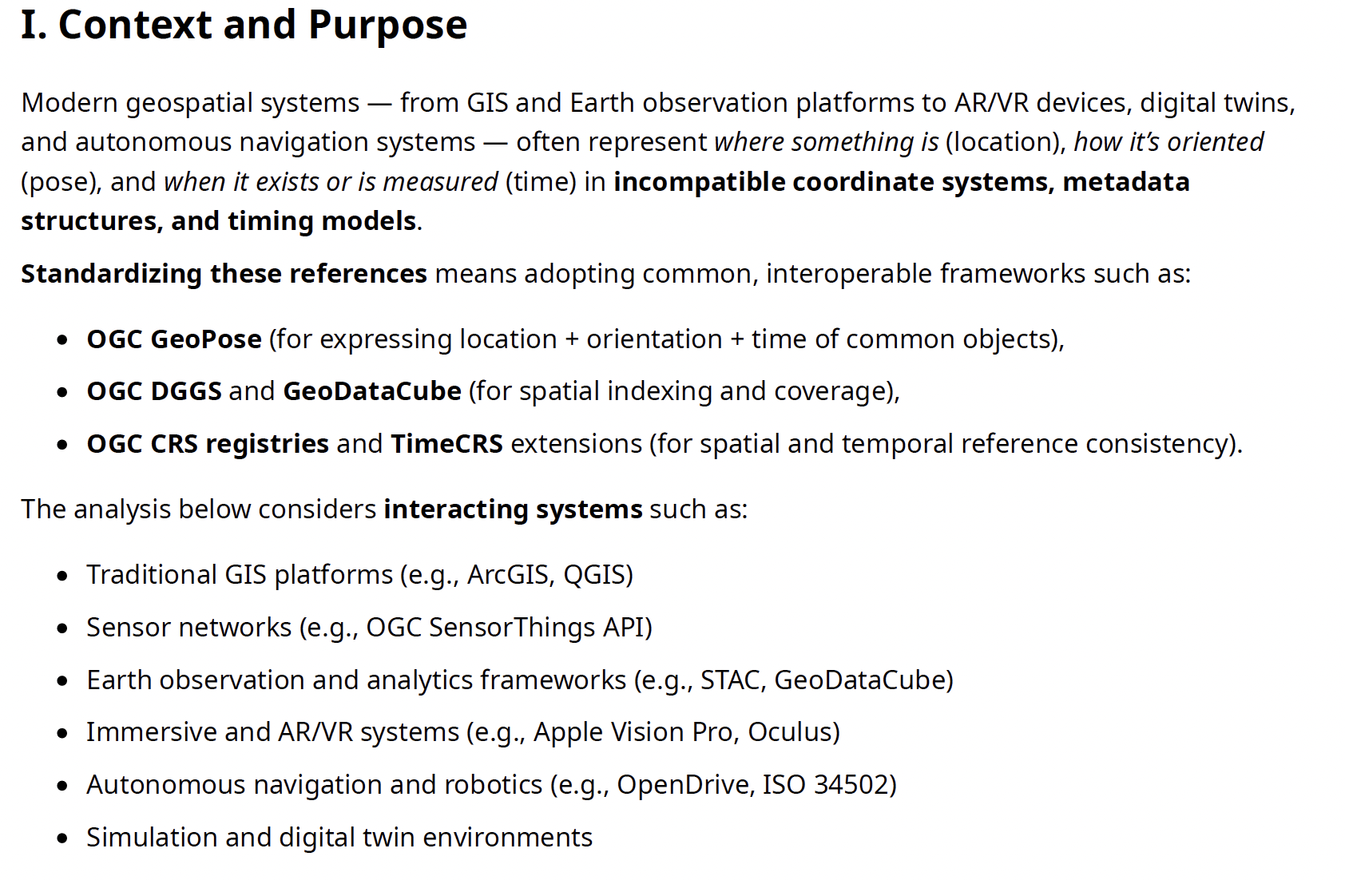
Chat response. Header…
Somewhat gratifying that the ”naturally occurring” systems for pose line up pretty well with the “grab-bag” proposed earlier.

Slide 14
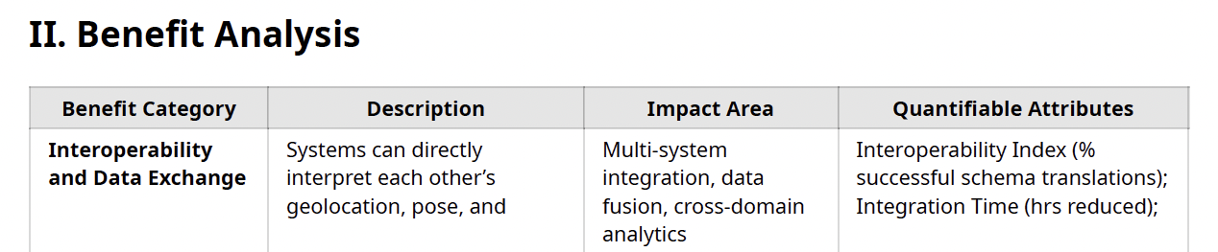
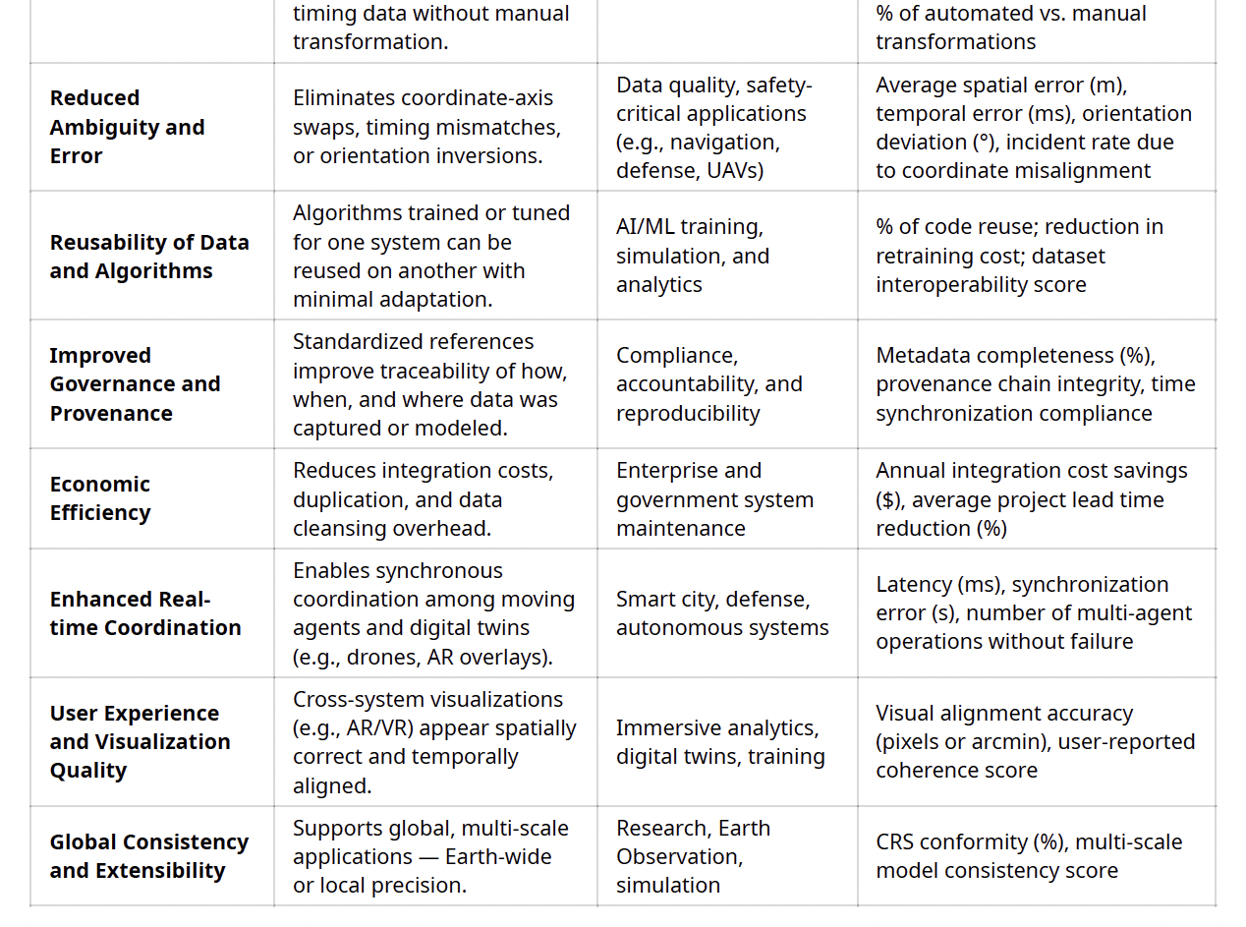
Benefits?
The idea (here) is that we organize the analysis of costs and benefits into a set of analyzable categories
Quantifiable so that we can aggregate, average over them, etc.
Generated by ChatGPT5 – seem like a useful starting point
But might like to reduce from eight to just a couple if possible , e.g.,
Lifecycle development affordances (increase skilled labor pool)
Immediacy of results at runtime
Representational fidelity
Network effects of integrated apps

Slide 15
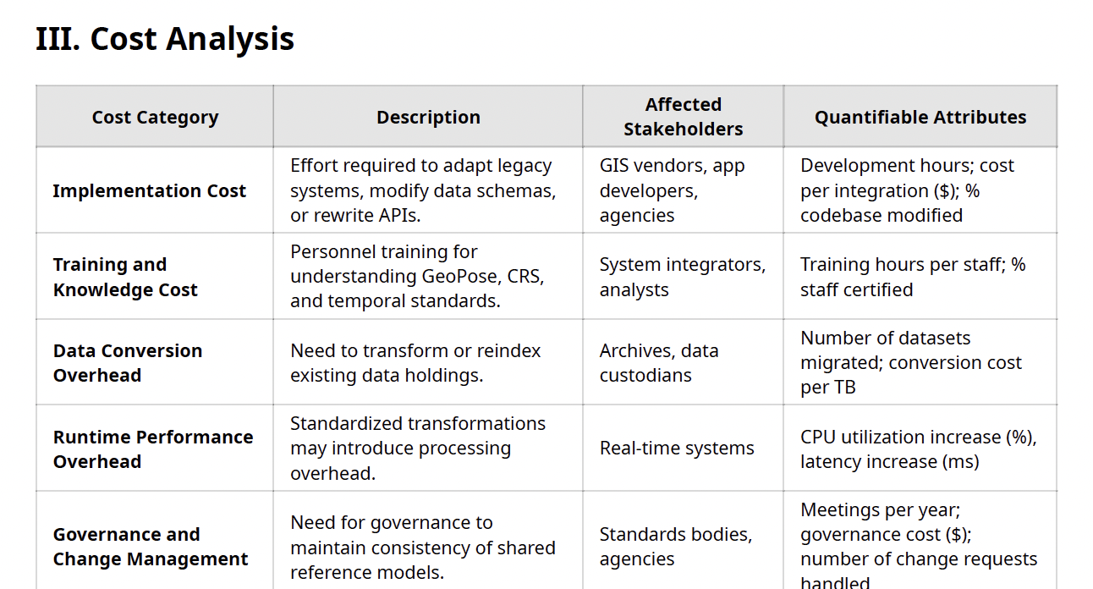
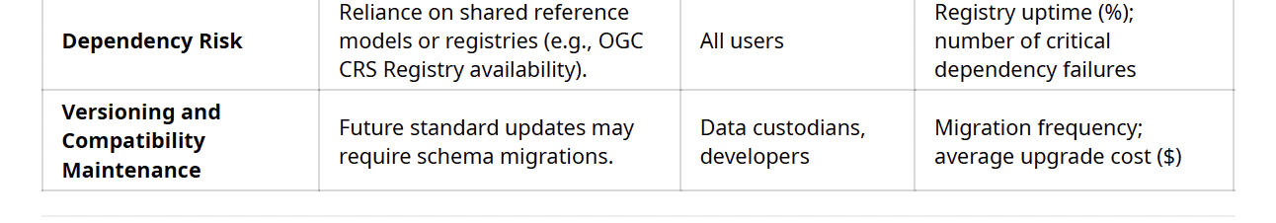
Costs?
Quantifiable, even if only in principle, and in practice have to make SWAGs at levels of cost (and benefit)
Again - a useful starting point, and especially good for checking if have a sufficiently comprehensive model
But would like to reduce to some smaller number for costs as well, e.g.,
Lifecycle development costs
Runtime latency impacts
Representation mapping impacts (e.g., 2D-3D)
Computational impact of Network effects

Slide 16
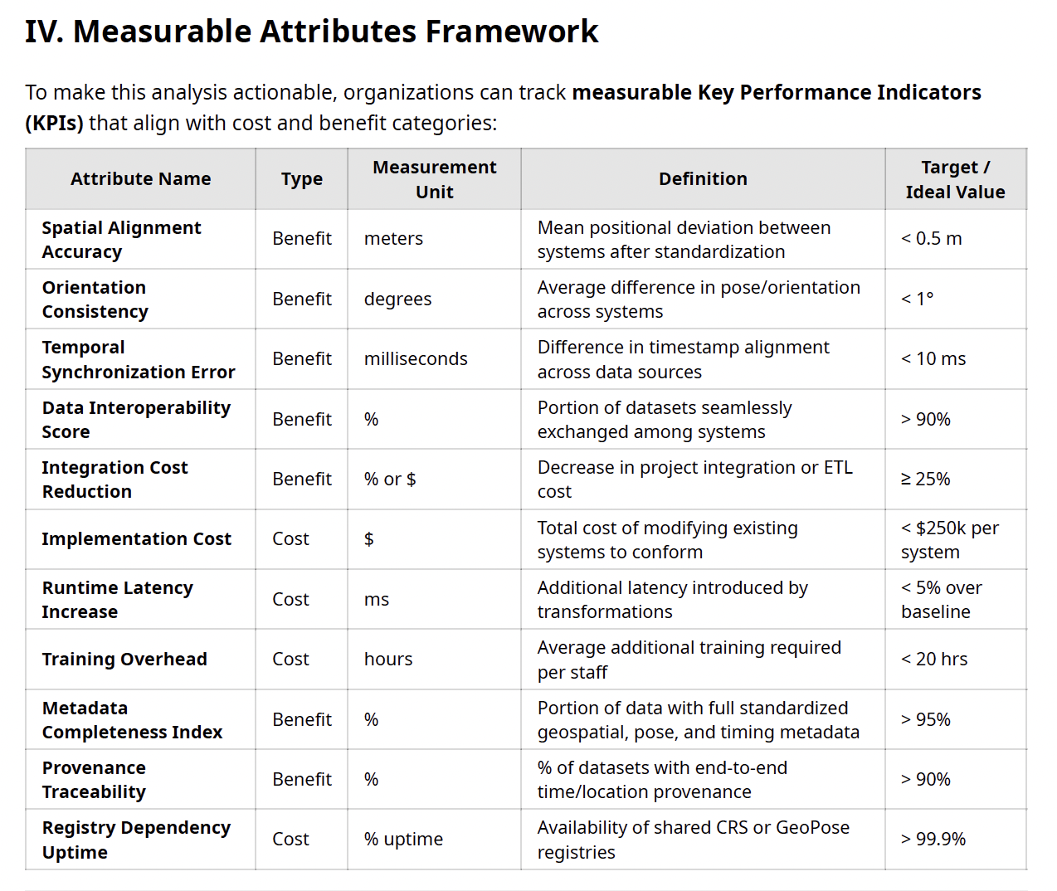
Measurable Attributes?
Actionable performance indicators
… but need to be reconciled to the Quantifiable Attributes of the previous charts
Notes:
Wrt accuracies/confidence?
Costs incl. redesign/implementation of weights as probabilities.
Benefits incl. Combination of fragmentary evidence across the (standardized) community?
Wrt latencies of various kinds?
Costs incl. redesign/implementation of compliant interfaces.
Benefits incl. Immediate integration of disparate capabilities – realtime exploitation
Wrt accuracies/confidence? (Prob not for thematic, only for positional/temporal values)
Costs incl. redesign/implementation of pose values as uncertain.
Benefits incl. Better reflection of reality – vagaries of situational info.
Wrt latencies of various kinds?
Costs incl. redesign/implementation of compliant interfaces.
Benefits incl. Immediate integration of disparate capabilities – realtime exploitation of locational info (that is discovered – through Findabilty and Access – in the environment)
Wrt conventions for formatting pose elements across apps?
Costs incl. redesign/implementation of compliant interfaces.
Benefits incl. avoidance of wrongly-ordered xyz/ptv axes (with resulting upside-down presentation of scene elements, etc.
Wrt integrating pose elements from info elements of different dimensionalities (e.g., placing 3D object on 2D maps)?
Costs incl. design of default for missing higher dimensions for lower-dimensioned data elements, coming up with a way to account for reduction in confidence for inclusion of defaults.
Benefits incl. significant expansion and integration of info sources.

Slide 17
Progress < Heatmap of risk/reward landscape .

Slide 18
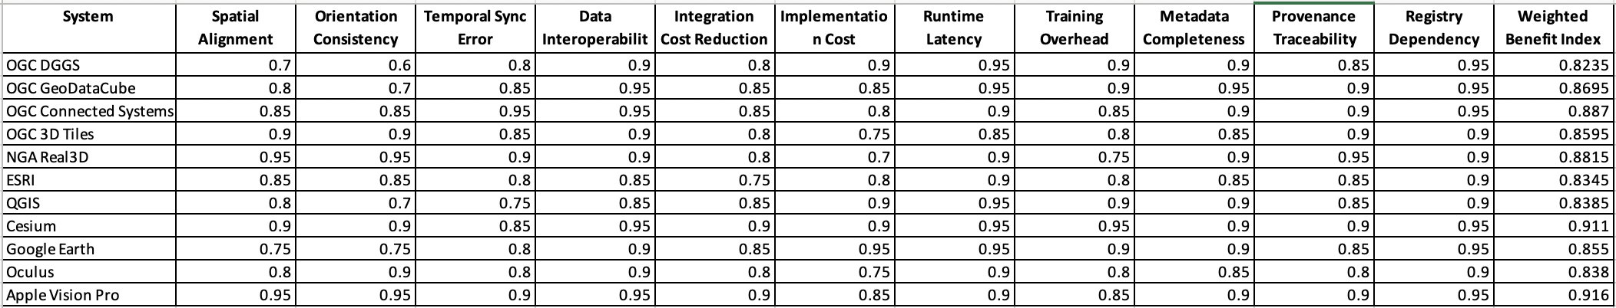
Estimated Scores for selected systems
(Putting words in peoples mouths in the hopes that they take the trouble to spit them out, i.e., they engage)

Slide 19
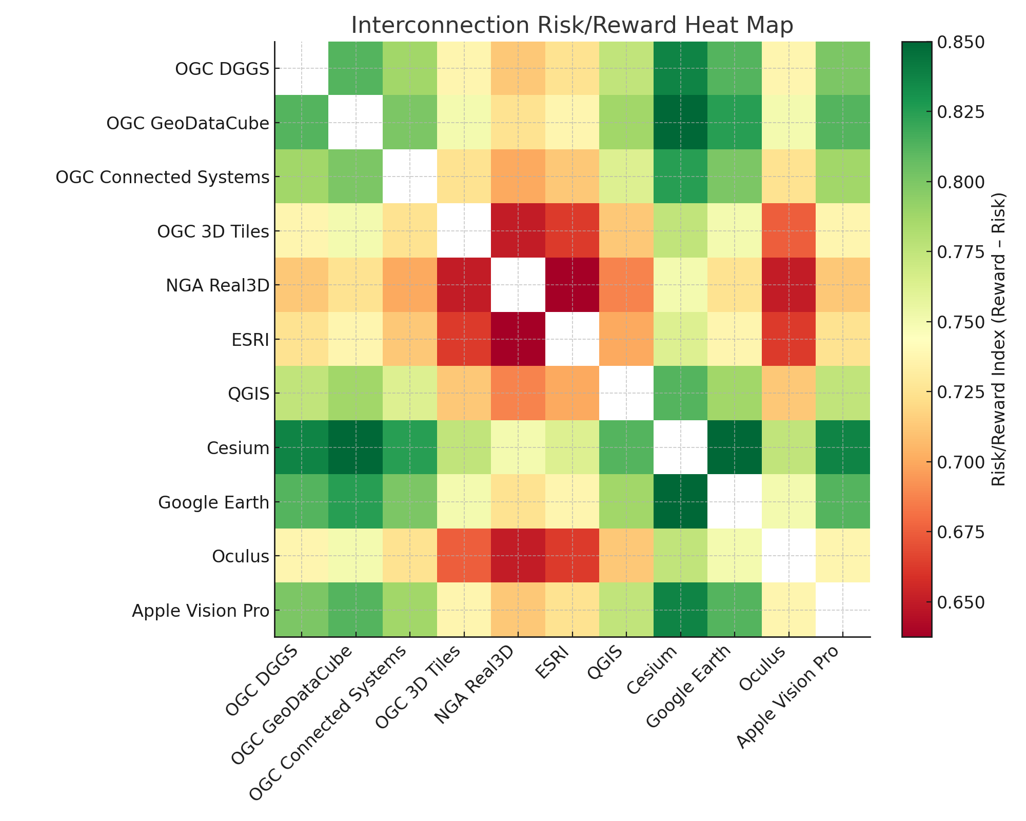
Cool Idea: ChatGPT Risk/Benefit Heat Map (with margins = payoff for adding app to fully integrated ecosystem)
Progress < Heatmap of risk/reward landscape

Slide 20
Next: Rinse, Repeat… Rethink?

Slide 21
Critique and re-instantiate this analysis...
So far – have just provided a sketch of a possible approach to achieving adoption
Decide whether to reify the cost-benefit tables with real numbers
Are these numbers believable?
If not, how can we make them believable?
Believable to whom?
Recruit stakeholders who care about these costs and benefits
Recruit specialists who can refine the parameter space of costs, benefits for this analysis
Recruit practitioners who can provide estimates for these parameters
Bring the results back to stakeholders and engage in the decision process
In NGA – the GWG Focus Groups provide a channel for this
Notes:
Measures…
Adoption by whom for what…
Developer costs – “Mythical Man Month” (thank you Fred Brooks)
Latency – one clocktime sec (at 60mph = 60*5280/(60*60) = 80ft; at 100km/h = 100*1000/3600 = 27.8M)
Accuracy/representational fidelity to a problem of interest?
Percent of community of interest that has adopted?
Suggest a deepening of motivating scenario (incl programming actions req’d for interop of diverse tools)
E.g., Two or more Geo information processing devices/agents exchanging (graphical/textual) gestures to indicate the locations of objects in their common environment, e.g.,
Tip-and-Cue
GeoVis-to-GeoVis
ISR/Tracking/Activity-based Intel
Automated Driving
Augmented Reality

Slide 22
But… What community are we aiming to establish?
Approach < Cast as a cost-benefit analysis & decision
Probably need measures of Network Effects
for Interoperability
Local to NGA?
NSG (NGA lead in GEOINT for DoD/IC)?
Joint operations (i.e., Army/AirForce/Navy/Marines)
and across DoD-Intelligence Community
ASG (including FVEY)?
Aussie, Brit, Canadian, New Zealand, and US
NATO?
Partnerships/Ad Hoc Coalitions?
All – including Adversaries?
NGA
NSG
FVEY/
ASG
NATO
Partners
All
Levels of integration:
Individual developer = Debugging
Developer team = conventions
Multiple components = system integration
Organization w mult apps = Enterprise integration
Multiple local organizations = Small “s” standardization
Multiple global organizations = Cap “S” Standardization
Notes:
Cost/Benefit Framework: Findability/Access/Interoperability/Re-Use
Wrt what community/market?
Local to NGA
NSG (NGA lead in GEOINT for DoD/IC)
Joint operations (i.e., Army/AirForce/Navy/Marines) and across DoD-Intelligence Community
ASG (meaning just FVEY or also NATO?)
DISR Standards often adopted as well by FVEY allies (Aussie, Brit, Canadian, New Zealand, and US)
“Coalition of the Willing”-like partnerships (e.g., India, Philippines, Vietnam, Japan…)
Adversaries? (Russia, China, Iran, N.korea, Cuba)

Slide 23
Next Stop: Additional FC’s of the GEOINT Standards Working Group (GWG)
Goal < propose a Standard way to express uncertainty/confidence in GeoPose
Covering NGA, NSG, ASG, NATO…
Imagery
GEOINT Media Standards Board (GMSB) Focus Group
Motion Imagery Standards Board (MISB) Focus Group
National Imagery Transmission Format Standard (NITFS) Technical Board (NTB)
Image Quality Standards Working Group (IQSWG)
Community Sensor Model Working Group (CSMWG)
Overhead Persistent Infrared Technical Board (OTB)
Metadata and Encodings (ASM FG)
Application Schemas and Metadata Focus Groups (ASM FG)
Portrayal (PFG)
Portrayal Focus Group (PFG)
Protocols and Services (GWS)
Geospatial Web Services Focus Group
Disciplines (WGSG)
World Geodetic System and Geomatics Focus Group
Community of Interest
Engage for v.2?
Engage for v.2?
Engage for v.2?
Submitting here
Community of Interest
Notes:
Bullet DoD and Intelligence Community (IC) Standards are adopted through the Joint Enterprise Standards Committee (JESC)
DoD Standards are written into the Defense Information Technology Standards Registry (DISR)
IC Standards are written into the IC’s Enterprise Registry and Repository (ER2)
USGS?
Geo Entries to the DISR and ER2 are managed though the GEOINT Working Group (GWG)
The GWG conducts its business through about a dozen Focus Groups
The GeoPose Standard is being considered by GWG’s GWS FG
The GWG is very familiar with OGC and has adopted many of OGC’s standards as Mandated across the DoD and IC.
But note: Change of the guard in NGA’s OGC work from Amanda Morgan to Mirsada Beganovic

Slide 24

THANK YOU
www.ogc.org

Slide 25
Innovation
Community
Standards
120+ Innovation Initiatives
380+ Technical reports
OGC hosted services
GeoCipher
OGC Advice and Capabilities building
550+ Members
60+ Alliance partners
50+ Standards Working Groups
45+ Domain Working Groups
25+ Years of Not for Profit Work
65+ Adopted Standards
300+ products with 1000+ certified implementations
1,700,000+ Operational Data Sets Using OGC Standards
Testbed 19 Demonstration and Outreach |

